Slide 1
Trait biogeography paper
Figure 1

Slide 2
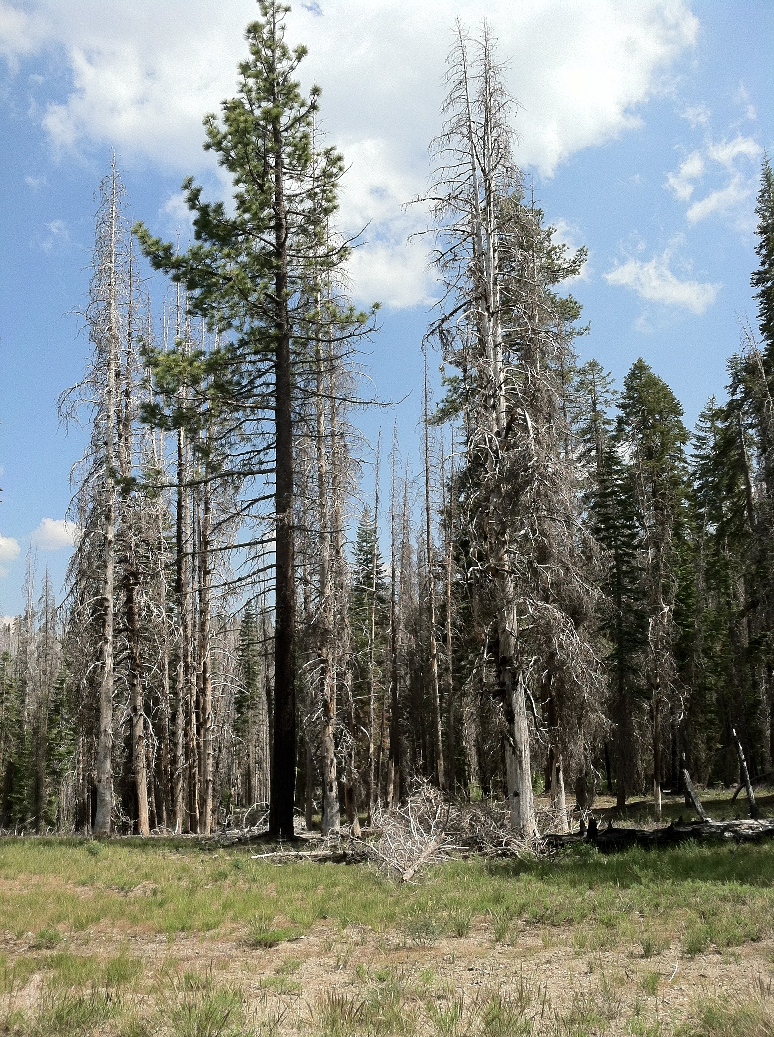
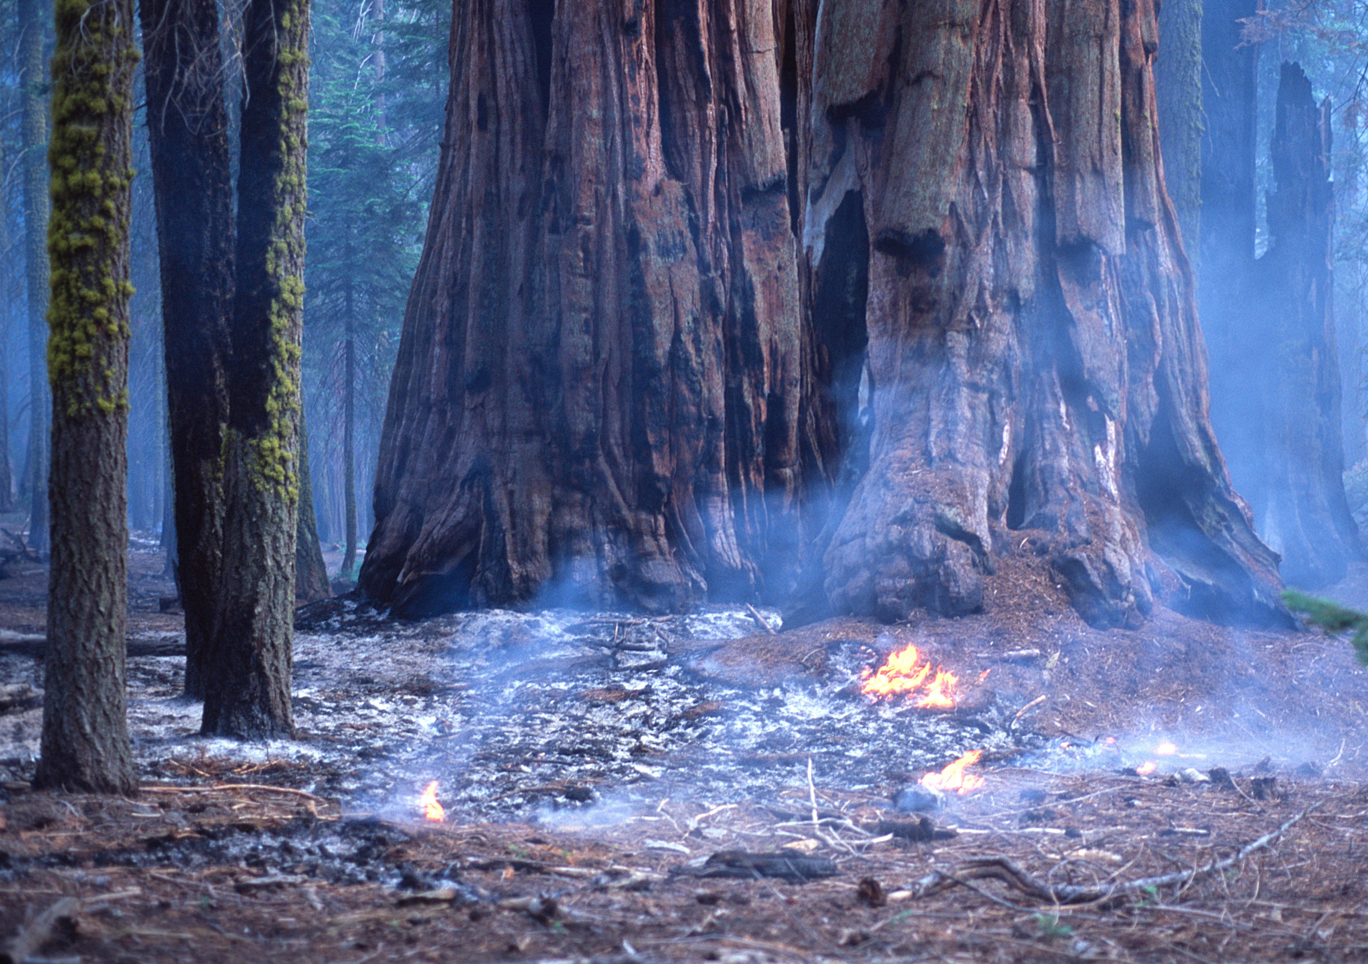
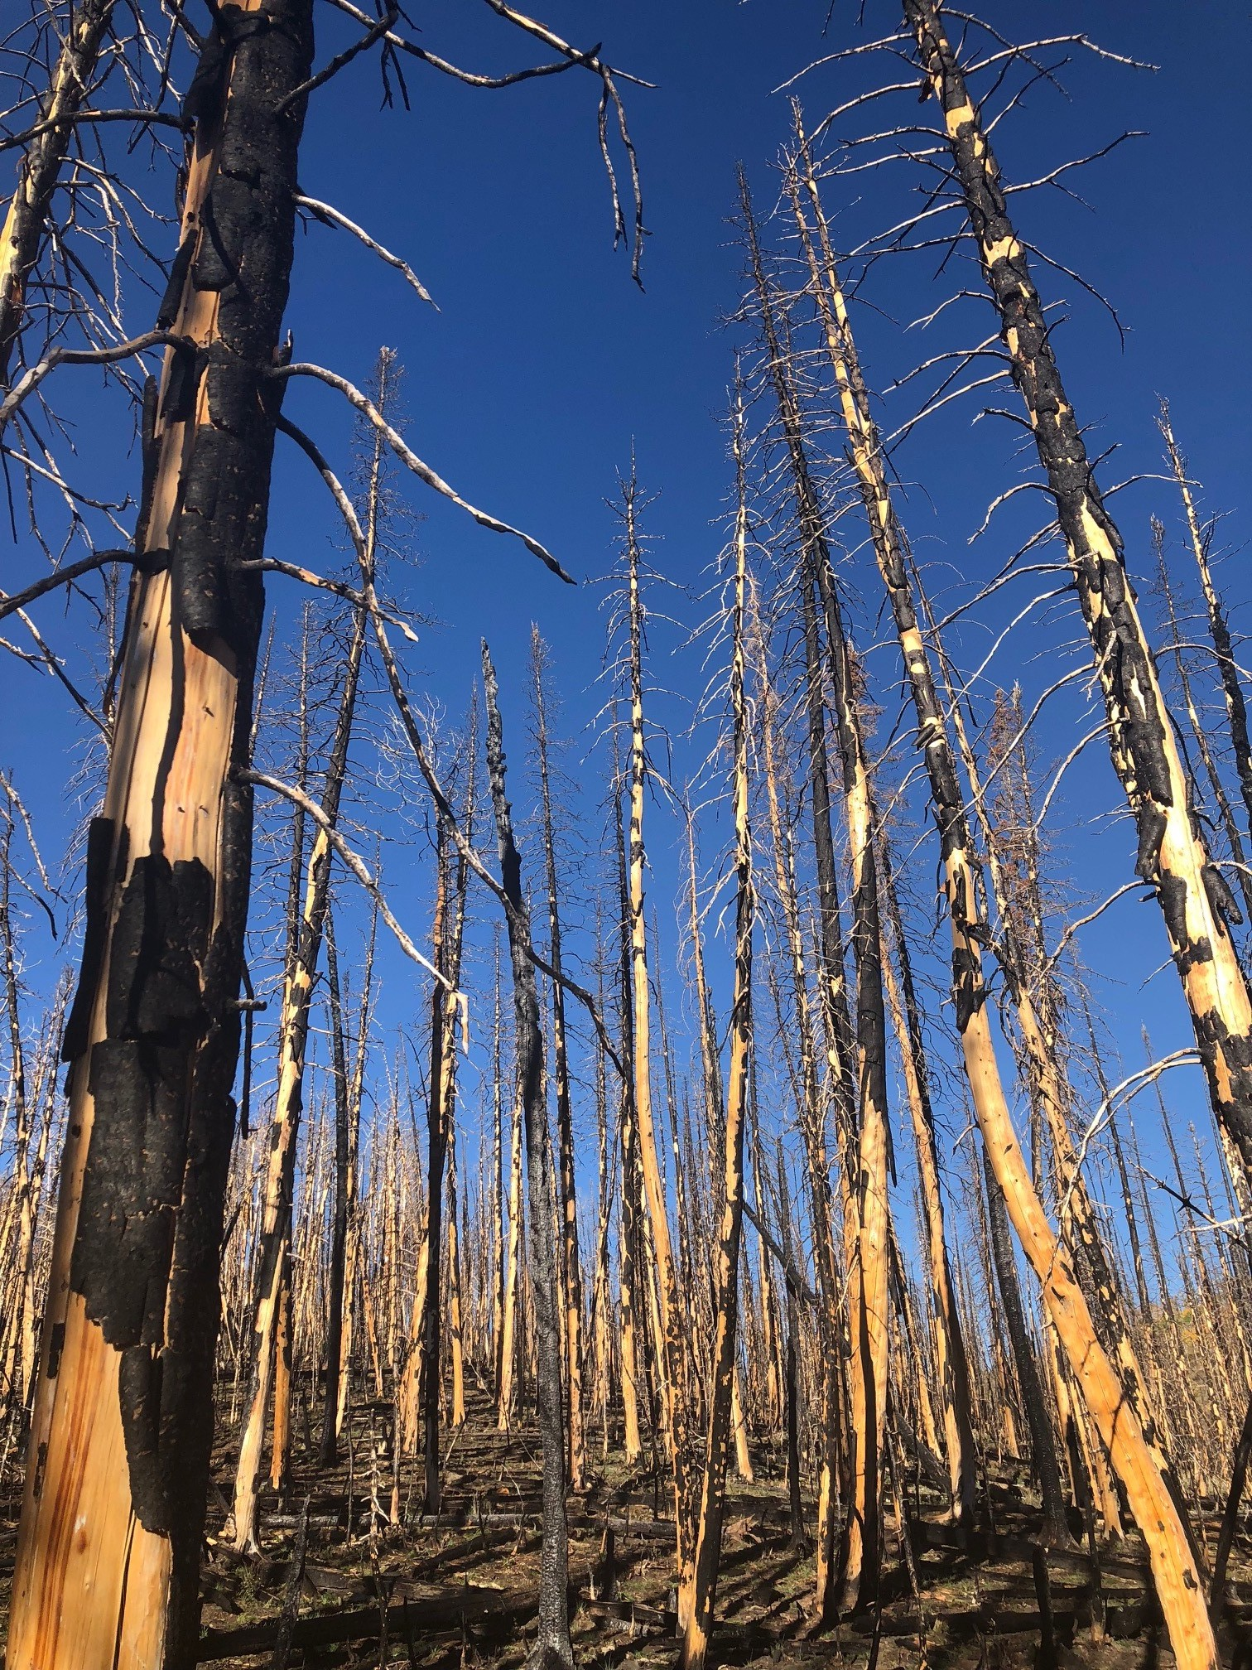
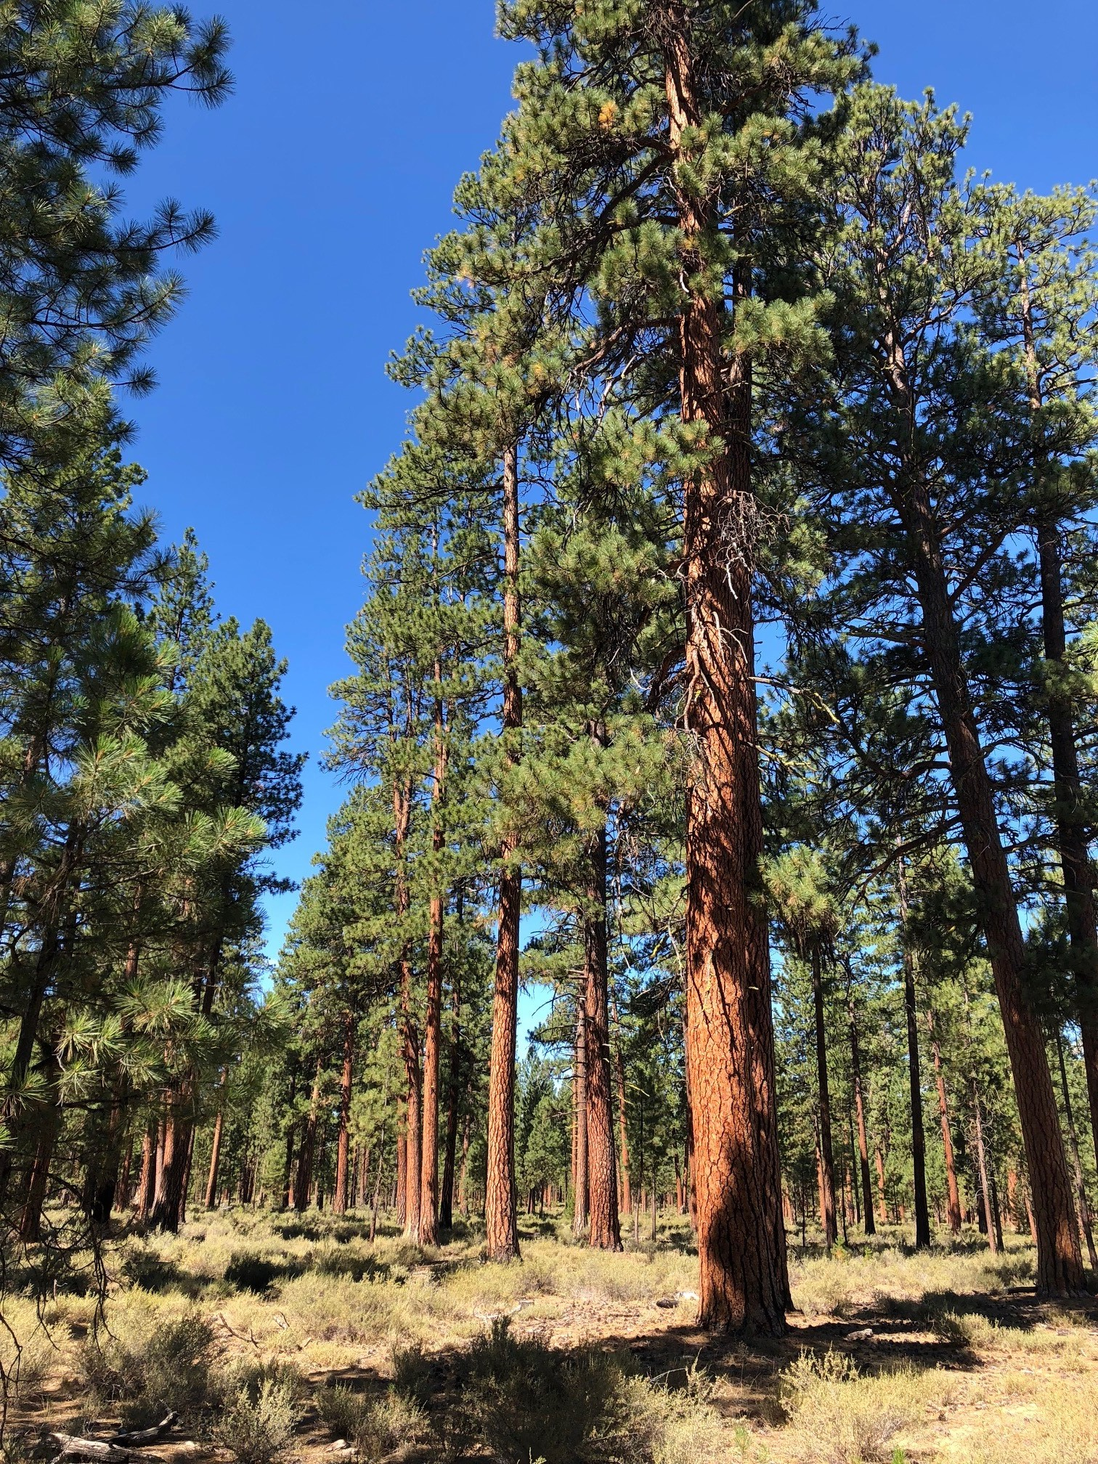
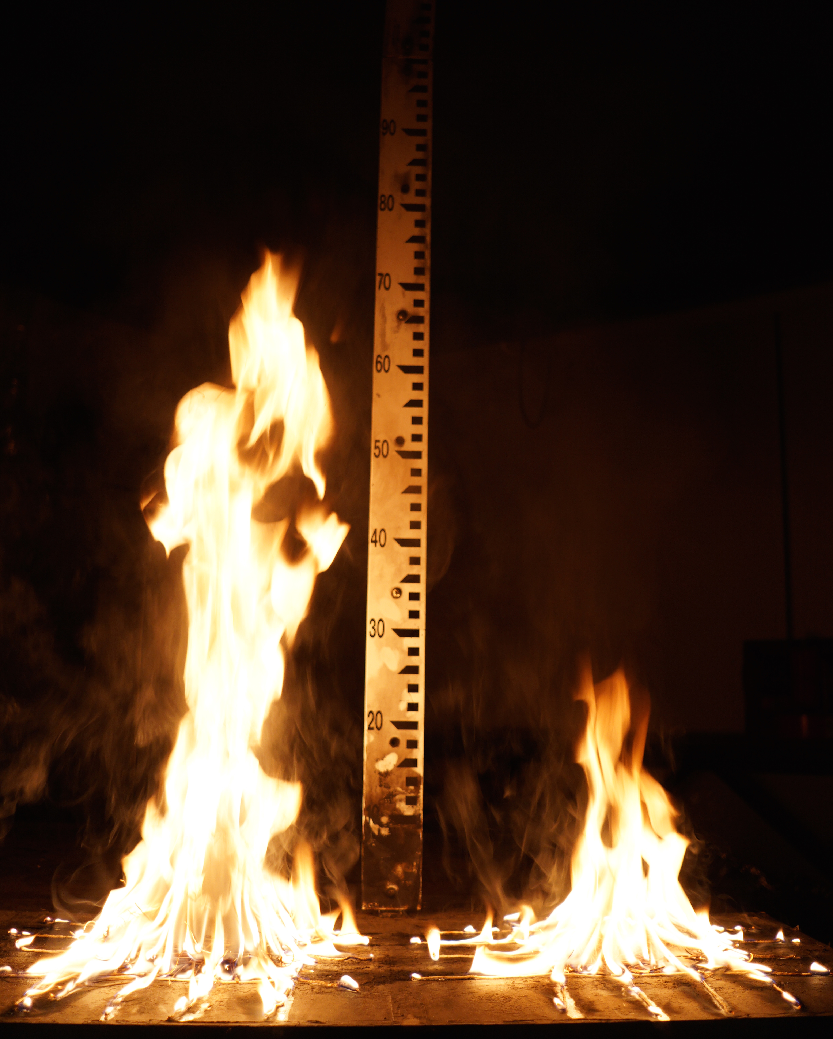
a
c
d
e
b

Slide 3
Caption:
Examples of fire resistance and flammability traits of different conifer species. (a): Pinus jeffreyi (left) and Pinus contorta (right) following the 2012 Reading Fire, Lassen National Park, California. The two species experienced similar fuel environments (fairly open-grown), with the Jeffrey pine surviving and the lodgepole pine dying. Note the lower profile of branches on Pinus contorta, indicating a lesser degree of self-pruning. (b): example of litter flammability differences in Pinus jeffreyi (left) and Pinus contorta (right), with Pinus jeffreyi having greater flame heights and shorter flame durations than Pinus contorta for a given mass of fuel (Table 1). (c): the North American conifer with the thickest bark, Sequoiadendron giganteum, during a prescribed fire in Sequoia National Park, California. (d): stand of fire-intolerant Picea engelmannii killed by fire, Fishlake National Forest, Utah. (e): stand of fire-tolerant Pinus ponderosa that has survived several fires on the Deschutes National Forest, Oregon.
Photo credits: (a): Jens Stevens, (b): Jeffrey Kane, (c): Dylan Schwilk, (d, e): J. Morgan Varner

Slide 6
a
b
c
Log flame duration
(heat release proxy)
Log flame duration
(heat release proxy)
Flame height (cm)
(spread rate proxy)
Percent consumed
(spread rate proxy)

